Slide 1

Machine Learning Methods for Weather Forecasting
A comprehensive overview of various machine learning methods utilized in diverse ways to forecast the weather.
Basel Al-Dwairi 20221502065
Hazem Arar 20221502041
Omar Alamssi 20229502031

Slide 2
Agenda
Problem Statement and Proposed Solution
Data Sourcing Methodology
Data Preprocessing
EDA Overview
Model Implementations I
Model Implementations II
Model Implementations III
Model Implementations IIII
Conclusion

Slide 3
Problem Statement and Proposed Solution-1
Weather forecasting involves collecting data about the current state of the atmosphere, land, and ocean, then using meteorology to project how the atmosphere will change at a given place. This is done using computer-based models that take many atmospheric factors into account, with human input to refine the forecasts.
Core problems include:
  Computational Expense
  Non-Linearity
  Data Vulnerability
  Local Accuracy
Notes:
Computational Expense: Physical models are slow to run and expensive to scale for local, real-time updates.
Non-Linearity: Weather patterns are highly non-linear; small changes in wind speed or direction can lead to disproportionate changes in temperature that simple equations often miss.
Data Vulnerability: Raw data from local stations often contains "noise" or sensor malfunctions that can lead to wild inaccuracies in traditional statistical models.
Local Accuracy: Global models often miss local "micro-climates" or specific patterns unique to a city's historical behavior.

Slide 4
Problem Statement and Proposed Solution-2
Our Solution!
The usage of Supervised ML (Machine Learning) and TSA (Time Series Analysis) to create a more efficient forecasting engine. Rather than simulating complex physical models that represent the entire atmosphere, we train a model to “learn” specific historical data relevant to our Location and need.
Four proposed solution will be discussed.
Notes:
Computational Expense: Physical models are slow to run and expensive to scale for local, real-time updates.
Non-Linearity: Weather patterns are highly non-linear; small changes in wind speed or direction can lead to disproportionate changes in temperature that simple equations often miss.
Data Vulnerability: Raw data from local stations often contains "noise" or sensor malfunctions that can lead to wild inaccuracies in traditional statistical models.
Local Accuracy: Global models often miss local "micro-climates" or specific patterns unique to a city's historical behavior.

Slide 5
Data Sourcing Methodology
Data is retrieved from IBM/Weather Channel API.
Dynamically scrape URLs by injecting various specific locations and dates.
Libraries Used:
- requests, bs4, pandas, json, matplotlib, numpy, tqdm, sys

Slide 6
Data Preprocessing
Data Loading and String Cleaning
Temporal Standardization
Data Flattening

Slide 7
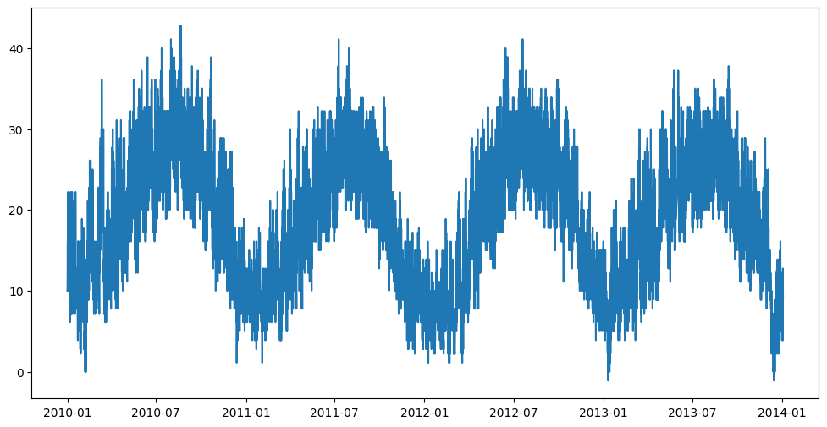
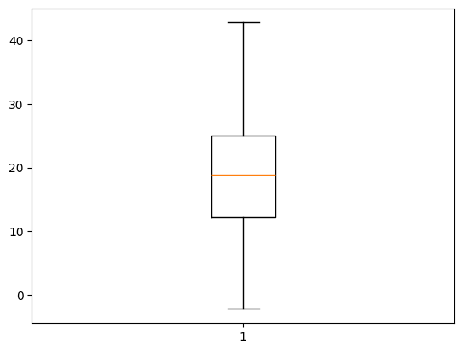
EDA Overview
Cyclical Feature Engineering
Outlier Detection and Error Correction
Categorical Encoding
Temperature mapped along date/time
Temperature Boxplot

Slide 8
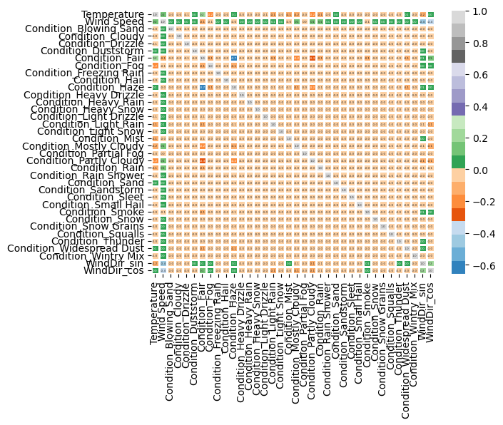
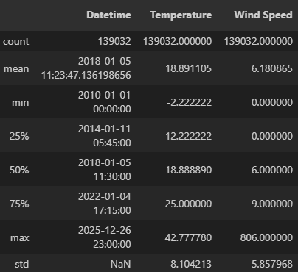
EDA Overview-2

Slide 9
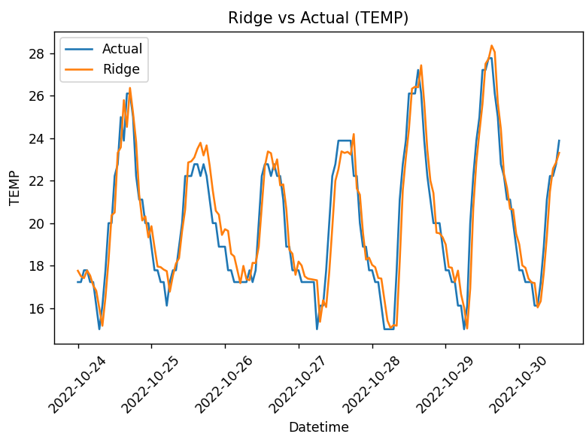
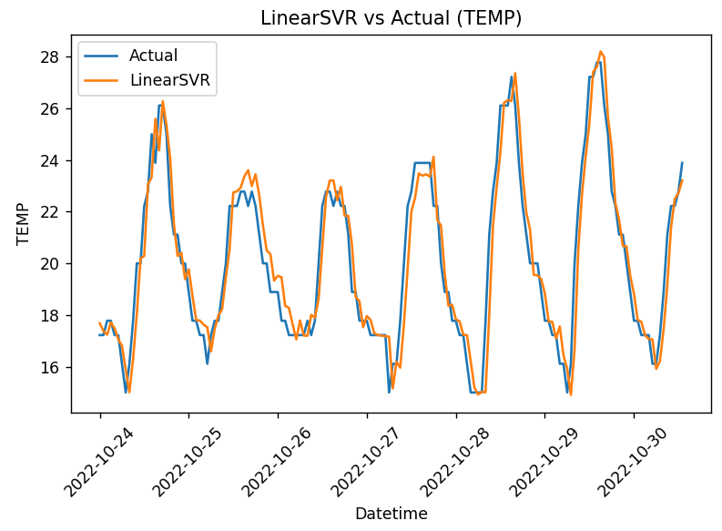
Model Implementations I
Linear & Regularized Regression
RIDGE | LinearSVM
0.892 | 0.880
1.187 | 1.185
0.977 | 0.97
Notes:
Write about Ridge and linear svr

Slide 10
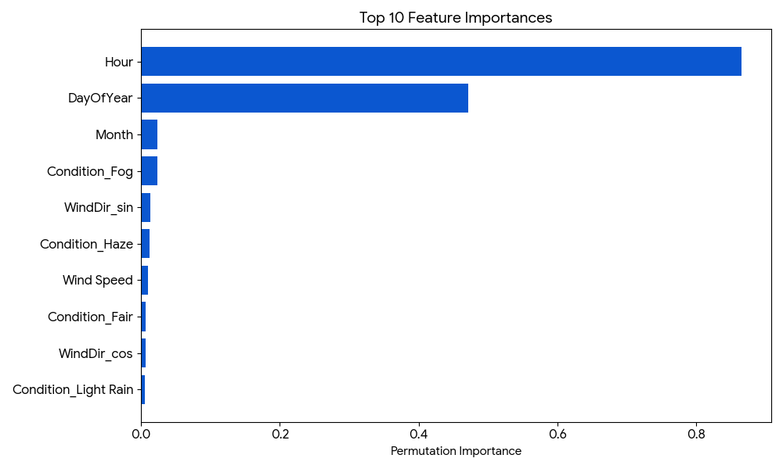
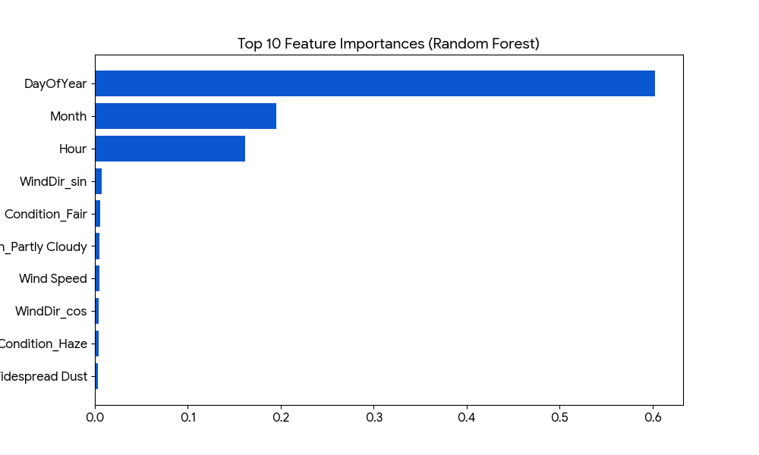
Model Implementations II
Ensemble & Tree-Based Models
-Hist Gradient Boosting Regressor from Scikit-Learn
-Random Forest
 | XGBOOST | RandomForest
MAE | 0.65 | 0.675
RMSE | 2.96 | 3.19
R2 | 0.863 | 0.84
Notes:
Random Forest & XgBoost

Slide 11
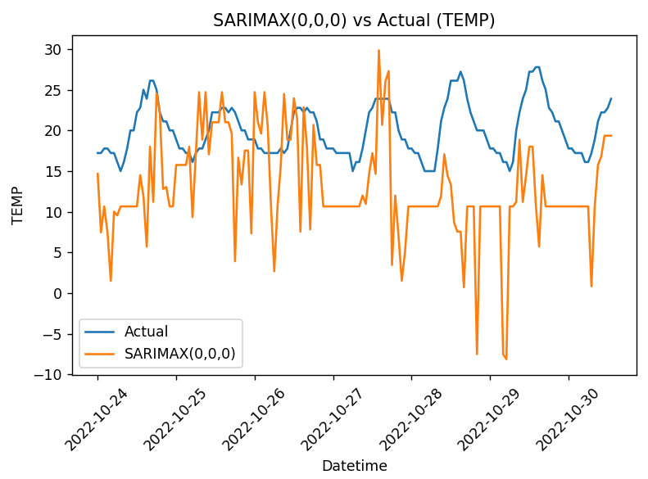
Model Implementations III
Dedicated Time Series Analysis (TSA)
Despite hyperparameter tuning, the SARIMAX model exhibited unstable forecasts and negative explanatory power. This behavior indicates that linear seasonal assumptions and fixed-order autoregressive structures are insufficient for capturing the nonlinear and evolving dynamics of hourly temperature data. Similar limitations of SARIMA-based models have been reported in high-frequency meteorological forecasting tasks.
MAE
RMSE
R2
SARIMA
7.773
9.533
-7.487
Notes:
SARIMA

Slide 12
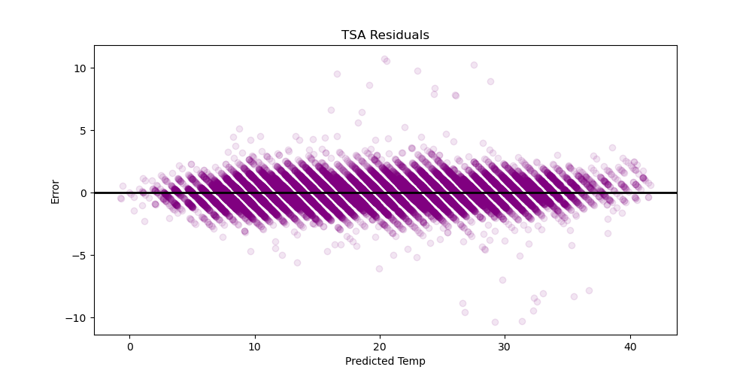
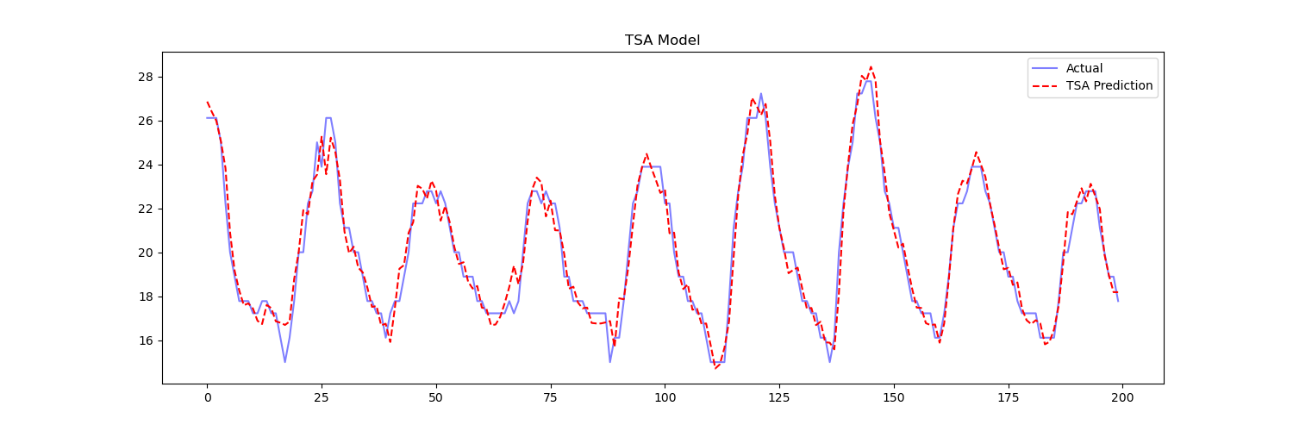
Model Implementations IIII
Hybrid (Regression + TSA)
-HistGradientBoostingRegressor from Scikit-Learn
-Lag Features
-Rolling Statistics
MAE: 0.655
RMSE: 0.881
R2 Score: 0.987

Slide 13
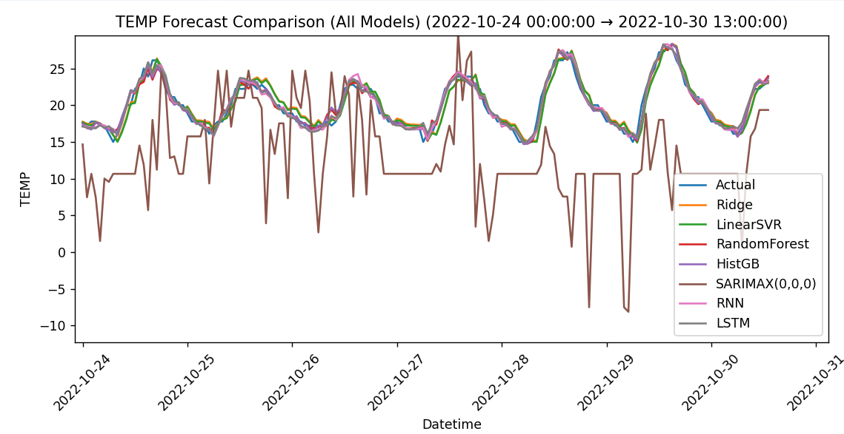
Conclusion
 | RIDGE | LinearSVM | RandomForest | XGBoost | SARIMA | HYBRID
MAE | 0.892 | 0.880 | 0.675 | 0.65 | 7.773 | 0.655
RMSE | 1.187 | 1.185 | 3.19 | 2.96 | 9.533 | 0.881
R2 | 0.977 | 0.97 | 0.84 | 0.863 | -7.487 | 0.987

